Slide 1
DOTA2
The balance of the game
Tao Cheng & Sijia Chen

Slide 2
Content
01
Topic review
02
Visualization
03
What and how we did
04
Conclusion

Slide 3

01
Topic Review

Slide 4
01
02
03
Main idea
Motivation
Research question
To explore the win ratio which is the balance of the game,
To find a way to show that the game balance is off and should be adjusted.
More and more people are passing their free time on video games while DOTA 2 is one of the best games in the world.
Esports are also getting more attention.
How to visualize that the game balance is off?
How much data is properly need to justify our point?
Which factor influence the game result most?

Slide 5
Data
Description
Data
Questions
The data we used is found on Kaggle, DOTABUFF, OPENDOTA.
They are details on different heroes, teams and the related pick rate, win ratio, etc.
How does the win ratio affect the game balance?
Is the data able to reflect the result we want?
Notes:
这一部分 也许需要改动

Slide 6
02
Visualization

Slide 7
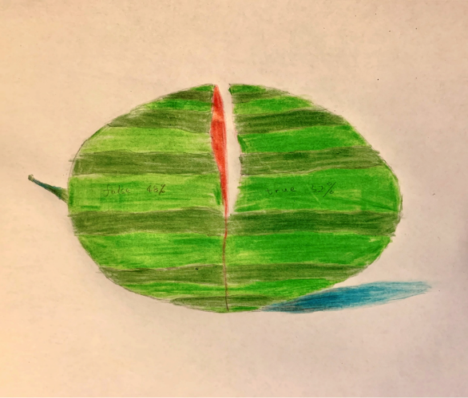
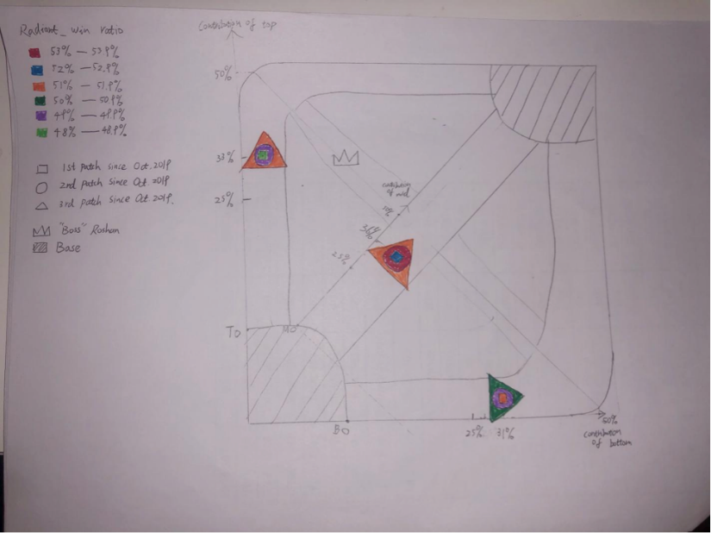
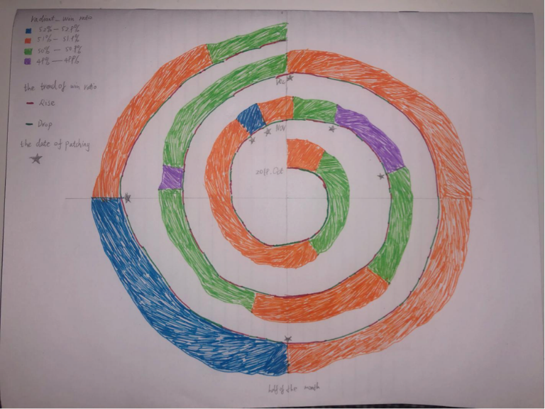

Slide 8

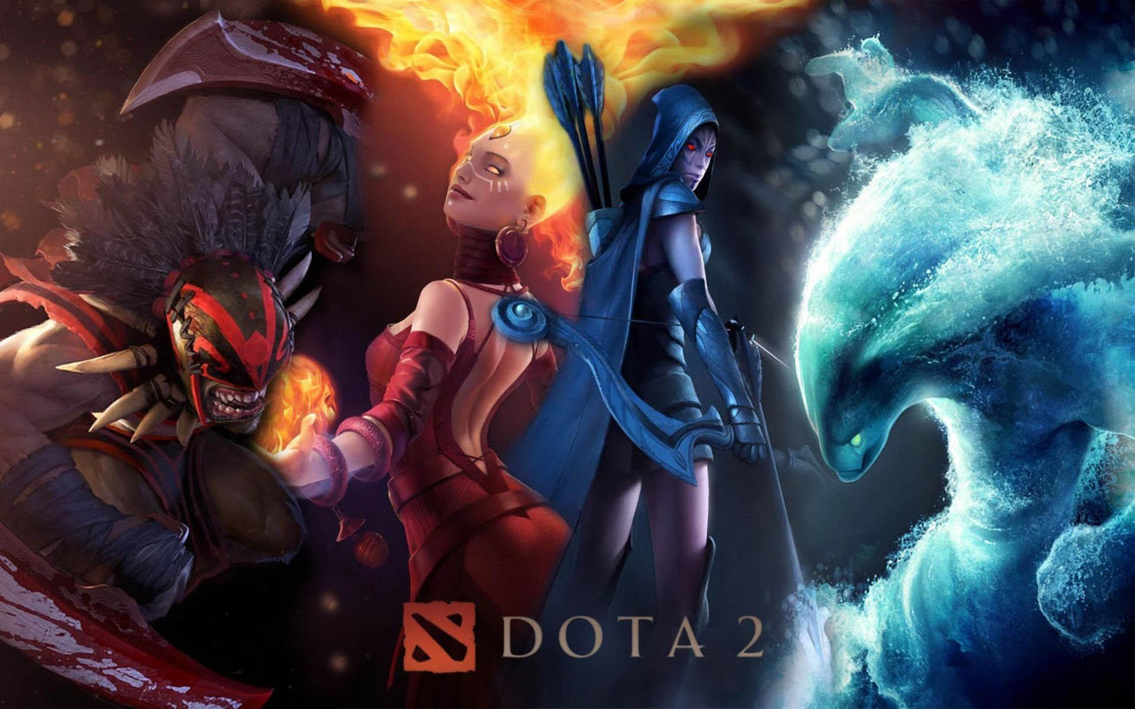

Dire
Win rate: 46.8
Win rate
On public matches in previous 24h, April 13.
Radiant
Win rate: 53.2

Slide 9
+
Overall
Visualization

Slide 10





Teams
Visualization
P.s. The total games counted in two fractions are different for each team, that is why the win ratio is not 100%.

Slide 11
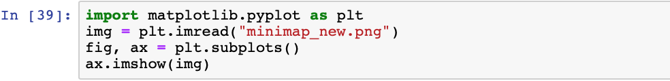
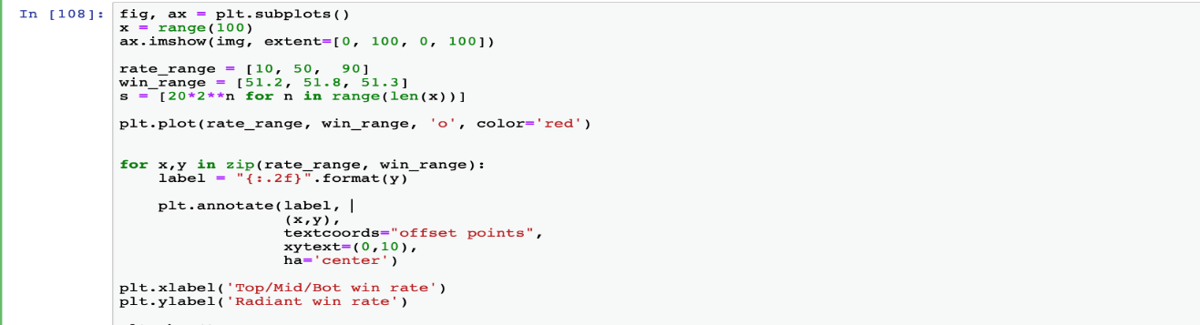
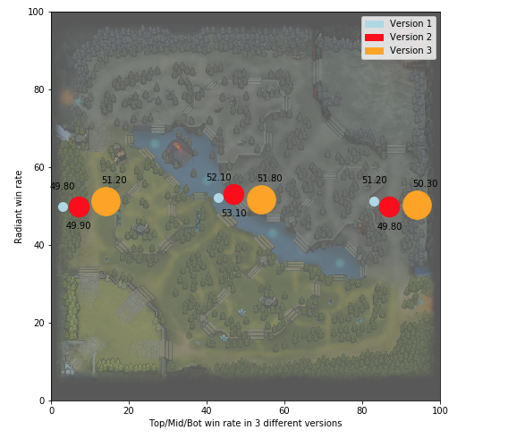
Coding +
Visualization

Slide 12
03
What and how

Slide 13
Step 1: Find the data we need on different websites.
Step 2: Play around with those data, filter the useful data.
Step 3: Make data understandable and visible.
Step 4: Prepare the PowerPoint to combine the results we got.
Overall
Find data
Filter data
Visualization
Presentation

Slide 14



Websites
Why these websites?
OPENDOTA
DOTABUFF
KAGGLE
Those websites have the best online resources for our project.
HOW?
Visualization
Trouble shooting
Patience is the best tool for all problems, and google helped a lot, thank you Larry and Sergey.
Excel charts, python are the tools we used to filter and visualize our data.

Slide 15
OPENDOTA: We used its explorer to find the win rate for different teams.
DOTABUFF:
We used its detailed hero stats to filter the win rate based on heroes got picked in different fractions
Kaggle:
Where it begins, we find the facts that Dota 2 is not balanced.
Excel, D3 and python:
The tools we create our visualizations.
Notes:
到这里介绍，编程时，你是怎么做的，如何根据数据做出visualization的效果，中间遇到了什么样的麻烦。

Slide 16
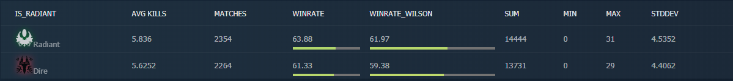

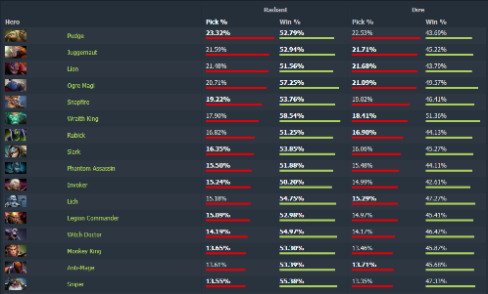
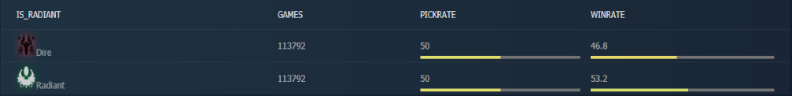
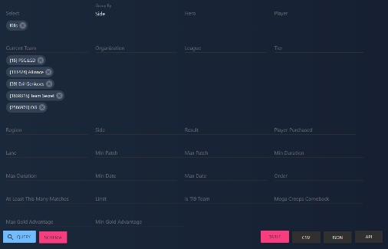

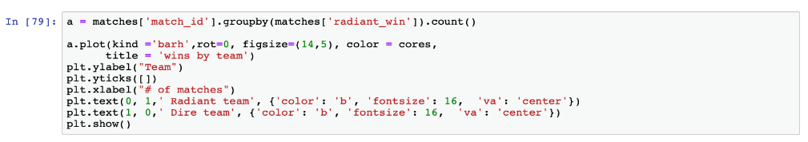
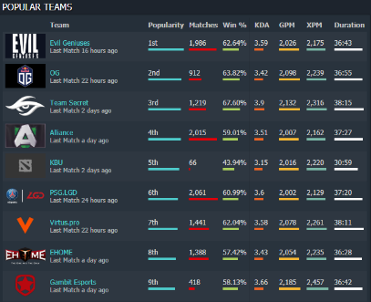
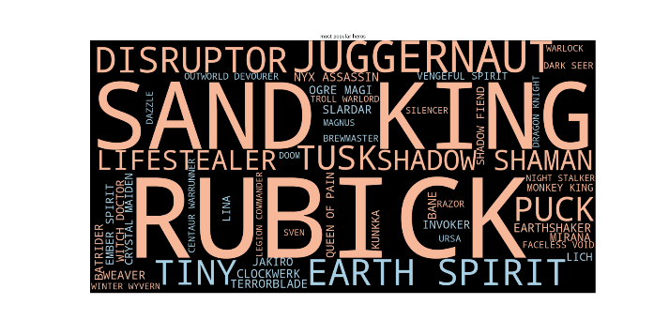
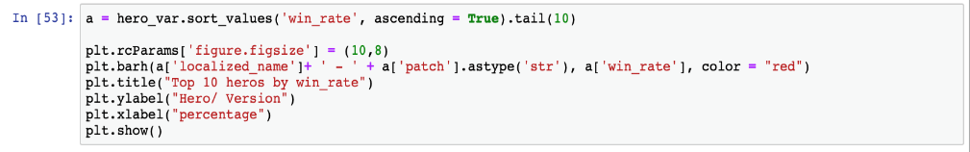
These pictures are from the data we researched online and some code fragments in our work.

Slide 17
04
Conclusion

Slide 18
Vision is the most important feeling in human beings
It is quite interesting to put the data, datasets and other resources into visualizations. Make the data understandable for more people.
The strengths and weaknesses
Future
direction
Discussion
Research
findings

Slide 19
What did we find?
01
According to the data and visualizations, we can easily tell that the radiant side has a higher win rate. Even the same hero could have a large different win rate in two sides of the map.
02
The map itself, is one of the major reason that causes this different win rate.
03
Players, behaviors, habits…
Those are all affecting the game results, and this is hard to be measured.
04
Not everyone in the community wants a so-called “balanced” game environment.
05

Slide 20

Different opinions:
Some part of Dota 2 community want a balanced game environment, while some part said that the game will never be balanced for good.
Dota 2 is not, and will never be balanced:
The game is designed such that A LOT of strategies can work if played right.
Once you use right and useful strategies, the charm of the game shows here.
It is better to keep this “balance” rather than make everything “equal”.
Game type:
This game is much way u can say Balanced for game play like u can see whatever the opponent team pick , u can pick counter heroes.
Balance needed!:
We just want a simple balanced game environment, no op heroes, no short resources on map distribution……

Slide 21
Weaknesses
The data we used are all from popular websites, so the statistics are likely to be correct. We have made all the charts very simple and easy to read and understand, so even if you have not played this game, you can understand the ideas we want to express.
According to past game versions, there is also a lot of information that is worth discovering, but we have put all the data together (versions) and did not elaborate separately. We could also put more heroes and teams or players into comparison, to find more information. In the end, we found that the map resources are too hard to trace, because the different items, places, refresher time are too flexible to be counted. We gave up on calculating on the map side.
Strengths

Slide 22
Research on player’ behavior and status may also be helpful.
Incorporate more player, team and version information during the analysis to achieve a more comprehensive analysis.
Future work direction

Slide 23
Thank
You
Any questions?
PPT模板下载：www.1ppt.com/moban/ 行业PPT模板：www.1ppt.com/hangye/
节日PPT模板：www.1ppt.com/jieri/ PPT素材下载：www.1ppt.com/sucai/
PPT背景图片：www.1ppt.com/beijing/ PPT图表下载：www.1ppt.com/tubiao/
优秀PPT下载：www.1ppt.com/xiazai/ PPT教程： www.1ppt.com/powerpoint/
Word教程： www.1ppt.com/word/ Excel教程：www.1ppt.com/excel/
资料下载：www.1ppt.com/ziliao/ PPT课件下载：www.1ppt.com/kejian/
范文下载：www.1ppt.com/fanwen/ 试卷下载：www.1ppt.com/shiti/
教案下载：www.1ppt.com/jiaoan/ PPT论坛：www.1ppt.cn

